Slide 1
Designing the User and System Interfaces
Chapter 6

Slide 2
User Interfaces and System Interfaces
User Interface – inputs and outputs that directly involve a human user/actor
A dialog goes on between actor and system
System Interface – the inputs and outputs that require minimal human intervention
Inputs captured automatically
Outputs direct to other systems
Printed and distributed outputs (statements, reports)

Slide 3
User Centered Design
Design techniques that embody the view that the user interface is the system to the user
Dates back to the 1980s (more for Mac)
Principles of User Centered Design
Focus early on users and their work
Evaluate designs to ensure usability
Use iterative development
Note that contemporary A&D finally incorporates these principles

Slide 4
Three Components of the User Interface

Slide 5
Metaphors of Human Computer Interaction
Direct manipulation metaphor
metaphor in which objects on a display are manipulated to look like physical objects (pictures) or graphic symbols that represent them (icons)
Desktop metaphor
metaphor in which the visual display is organized into distinct regions, with a large empty workspace in the middle and a collection of tool icons around the perimeter
Document metaphor
metaphor in which data is visually represented as paper pages or forms
Dialog metaphor
metaphor in which user and computer accomplish a task by engaging in a conversation or dialog via text, voice, or tools such as labeled buttons

Slide 6
Metaphor Details

Slide 7
Direct Manipulation, Desktop, and Document Metaphors On One Screen

Slide 8
Dialog Metaphor

Slide 9
User Interface Design Concepts
Human-Computer Interaction (HCI)
A field of study concerned with the efficiency and effectiveness of user interaction with computer systems, human-oriented input and output technology, and psychological aspects of user interfaces
Visibility and Affordance & Don’t forget consistence of use
To be usable, a control must be visible to the user and its appearance should suggest its functionality
Media player controls, buttons, scroll bars

Slide 10
User Interface Design Guidelines
Design for Consistency
Provide Shortcuts
Provide Feedback
Dialogs Should Yield Closure
Error Handling that Provides Guidance
Easy Reversal of Actions
Reduce Short Term Memory Load

Slide 11
Use Cases and the Menu Hierarchy
We design use case by use case
Menus are a typical way to organize access to use case functionality
Different types of users might have different menus
Useful to design an overall menu hierarchy and then subsets for different users
Once the hierarchy is established, menus can be implemented in a variety of ways

Slide 12
Two Different Menu Styles

Slide 13
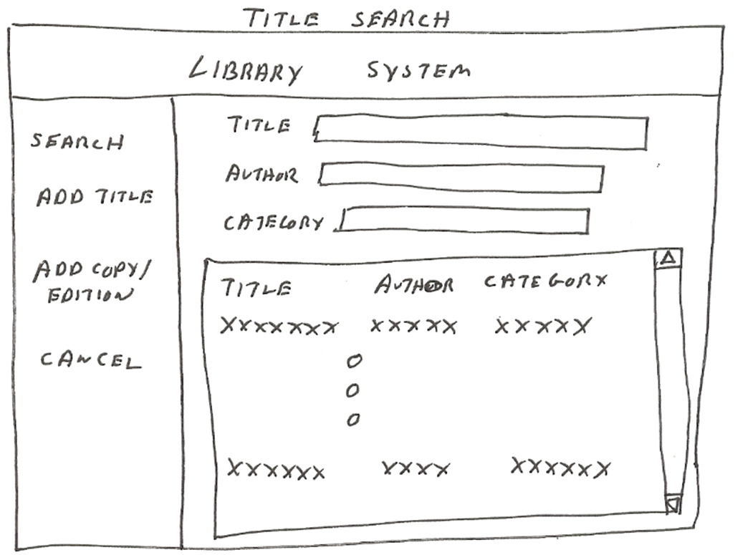
And a Third

Slide 14
Some RMO Use Cases Grouped by Actor and Subsystem

Slide 15
RMO Use Cases Grouped into First Cut Menu Hierarchy

Slide 16
Dialog Design
For each use case, think of the natural flow of a dialog between user and computer
Based on the flow of activities in use case description and/or the system sequence diagram
Use natural language to emphasize feedback to user
Create a storyboard of the dialog, showing the sequence of sketches of the screen each step of the dialog. (storyboarding)
Review the storyboard with users

Slide 17
From Dialog to Storyboard (part 1) Use case Check out shopping cart

Slide 18
From Dialog to Storyboard (part 1)

Slide 19
From Dialog to Storyboard (part 2)

Slide 20
From Dialog to Storyboard (part 2)

Slide 21
Guidelines for Windows and Forms
Interface Layout and Formatting
Consistency, labels and headings, distribution and order, fonts and colors
Data Entry
Text box, list box, combo box, radio buttons, check boxes
Navigation and Support Controls
Minimize, maximize, close, scroll bars, resize

Slide 22
RMO Windows Form

Slide 23
Guidelines for Web Browser User Interfaces
Consistency
Cascading Style Sheets (CSS) – Web page encoding standard that enables a Web site designer to specify parts of a page that will always look the same and parts that will vary by task or audience
Performance Considerations
Sensitive to network connection, amount of information transmitted, type of information transmitted
Pictures, Video, and Sound
Powerful, but compatibility issues arise
Users with Disabilities
Assistive technologies -- software (such as text-to-speech and voice-recognition utilities) that adapts user interfaces to the special needs of persons with disabilities

Slide 24
RMO Example Using CSS for Consistency

Slide 25
Guidelines for Handheld Devices
Challenges
Small screen size, small keyboards and touch screens, limited network capacity, app design guidelines and toolkits

Slide 26
Identifying System Interfaces Inputs/outputs with minimal human intervention
Inputs from and outputs to other systems
These are direct interfaces with other information systems, normally formatted as network messages.
Highly automated inputs and outputs
These are captured by devices (such as scanners) or generated by persons who start a process that proceeds without further human intervention.
Inputs and outputs to external databases
These can supply input to or accept output from a system.

Slide 27
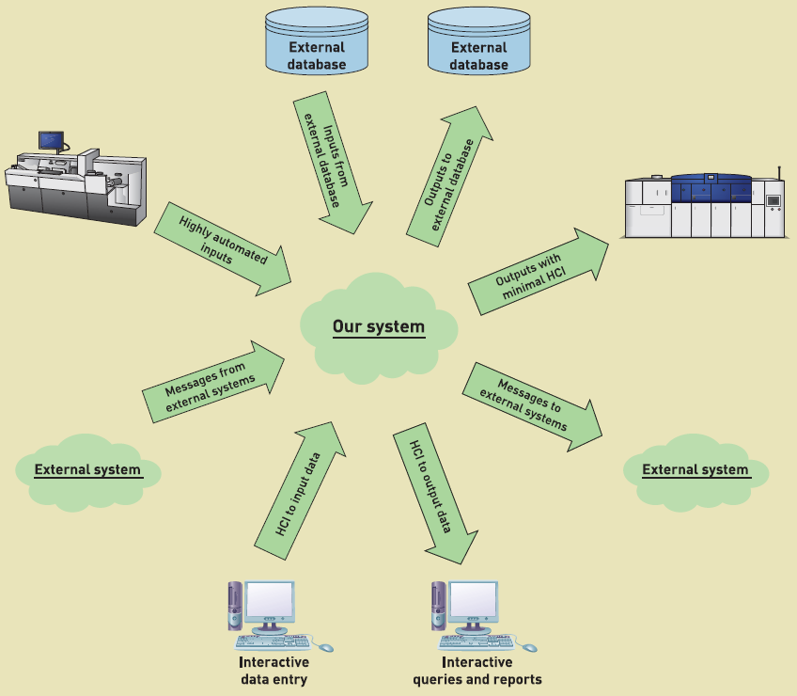
Identifying System Interfaces

Slide 28
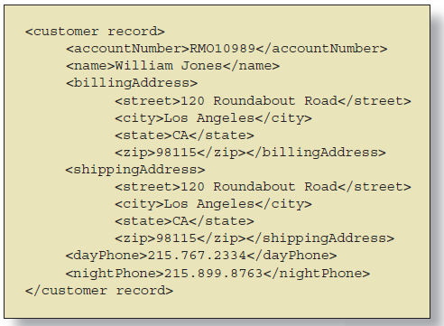
XML for System Interfaces
Extensible Markup Language (XML) -- extension of HTML that embeds self-defining data structures within textual messages
XML tags -- character sequences (such as <name> and </name>) that define the beginning, end, and meaning of the text that appears between them

Slide 29
System Inputs
Primary Objective is Error Free Input
Use electronic devices wherever possible
Avoid human involvement as much as possible
If information is already available in electronic form, use it instead of re-entering information
Validate and correct information at time and location entered
Device Examples
Magnetic card strip readers, bar code readers, optical character recognition, radio frequency ID tags (RFID), touch screen, electronic pens, digitizers, speech recognition

Slide 30
Defining System Inputs Details
Sequence Diagram
Details for messages

Slide 31
System Outputs
Detailed reports -- reports that contain specific information on business transactions
Summary reports -- reports that summarize detail or recap periodic activity
Exception reports -- reports that provide details or summary information about transactions or operating results that fall outside a predefined normal range of values
Executive reports -- reports used by high level managers to assess overall organizational health and performance

Slide 32
System Outputs
Internal outputs -- reports or other outputs produced for use within the organization
Types of internal reports apply here
External outputs -- reports or other outputs produced for use by people outside the organization
Statements, notices, stockholder reports
Higher quality, color, reflect image of organization
Turnaround documents -- external outputs that includes one or more parts intended to be returned with new data or information
Bills

Slide 33
External Output Example

Slide 34
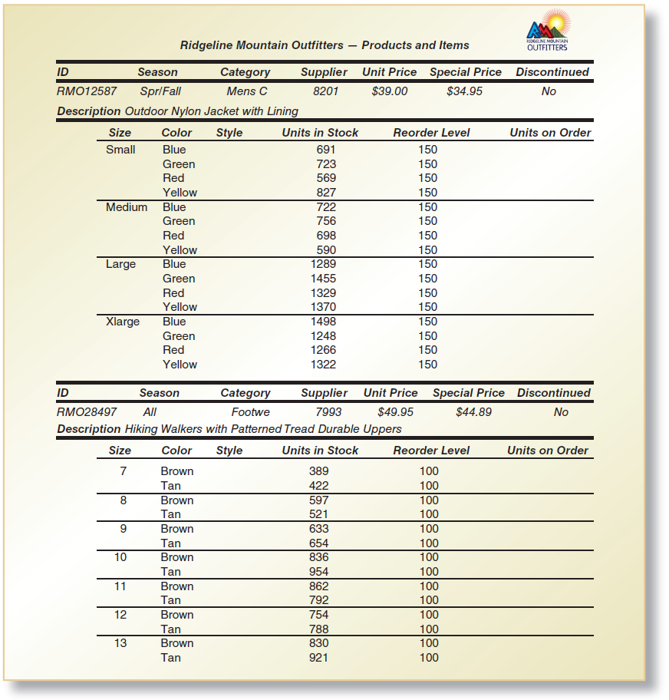
Internal Output Example Detailed control break report

Slide 35
Drill Down Online Report Summary and Detailed

Slide 36
Graphical Outputs

Slide 37
Summary
There are two types of interfaces – user interfaces and system interfaces
User interfaces involve direct user interaction with the system. System interfaces require minimal or no user interaction
The design of the user interface has a long history as human computer interaction (HCI) and relies on user-centered design, which focuses early on users and uses iterative development
Metaphors are used to think about the nature of the user interface, and they include direct manipulation, desktop, document, and dialog metaphors.

Slide 38
Summary (continued)
Key user interface concepts include affordance and visibility for controls
Other key principles include consistency, shortcuts, feedback, dialog closure, error handling, reversal of actions, and reducing short term memory loads
Use cases are organized into one or more menu hierarchies to arrange functionality for users
Dialogs and storyboards are used to design the interaction for each use case based on use case flow of activates and system sequence diagrams
Guidelines are available for designing for Windows, Web browsers, and Handheld devices

Slide 39
Summary (continued)
System interfaces include inputs and outputs to other systems, highly automated inputs and outputs, and inputs and outputs to external databases.
Designing system inputs involves identifying devices and mechanisms, identifying inputs and the data content, and determining the controls necessary
Designing system outputs includes designing detailed reports, summary report, exception reports, and executive reports
Outputs are also classified as internal, external, or turnaround
Electronic reports and other outputs can include drill down, graphics, and multimedia

